Slide 1
Computer Graphics ray tracing extras
László Szécsi szecsi@iit.bme.hu
AIT

Slide 2
Non-shadow-casters
some objects may not be shadow casters
emissive objects coinciding with light sources
transparent objects
shadow casters and non-shadow-casters must be separated somehow (like they are first and second part of array, or in different arrays)
shadow rays are only tested against shadow casters
findBestHit processes all objects (in consecutive loops)
findShadowHit processes only shadow casters

Slide 3
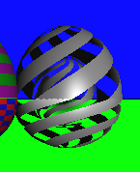
Procedural masking
Pinking
clipped quadrics are nice for solid surfaces
take the idea of clipping a step further
use some procedural function/texture to decide if the hit is on valid surface, or missing
does not have to be a noise function! use trig functions, fract
this means a modified intersect for affected objects
GLSL: different versions of intersection function (e.g. intersectClippedQuadric, intersectPinkedQuadric)
objects requiring different intersection functions are separated, processed in consecutive loops (they manage the same bestT, bestIndex)

Slide 4
Multi-clipped quadrics
use not one, but more clippers
different versions of intersection function
intersect2ClippedQuadric(0, 1)
intersect3ClippedQuadric(2, 3, 4)
intersect4ClippedQuadric(5, 6, 7, 8)
intersect5ClippedQuadric(9, 10, 11, 12, 13)
objects requiring different intersection functions are separated, processed in consecutive loops
useful for making two faces of a box: clip infinite slab by two orthogonal infinite slabs
for the other two pairs of faces, rotate the role of surface and clippers among the three quadrics
Box

Slide 5
Clipped solids (manifold surfaces)
switch roles of surface and clipper to get closing surface
the hole uses an inside-out cylinder for clipper/surface
rotate the role of the surface among three infinite slabs
Box

Slide 6
Emissive surfaces
eye-directional radiance from surface is constant
is ray hits, radiance along ray (returned by function trace) is a constant
could also have diffuse/specular/ideal reflection, but you will probably use it for lights sources, and emission will dominate anyway
light sources themselves are invisible! so non-shadow-caster emissive objects have to be placed to make them show up

Slide 7
Fresnel
stretch goal
Gold

Slide 8


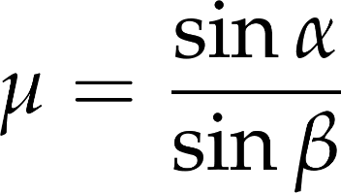
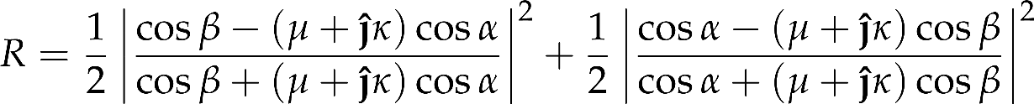
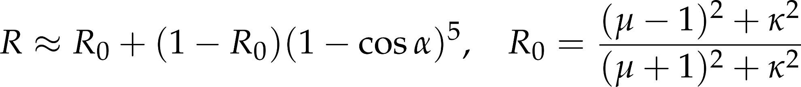

Refractive index and extinction coefficient
reflectance, transmittance, and exiting angle depend on material properties
reflective index
extinction coefficient
Snell’s law
Fresnel’s law
Schlick’s approximation

Slide 9
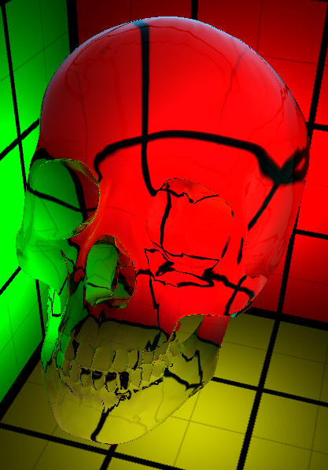

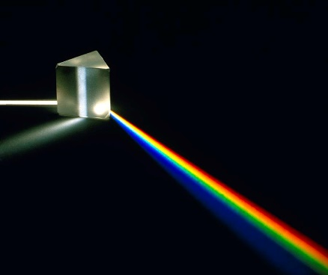
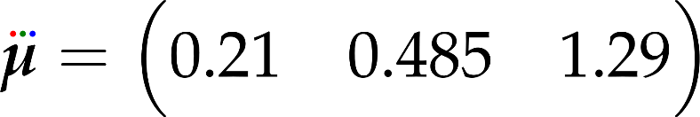
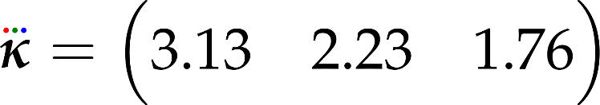

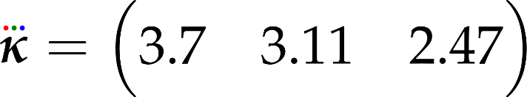


Metals and dielectrics
Metal
Dielectric
transmitted part is absorbed
reflectance depends on wavelength
we need RGB values
gold:
silver:
no extinction
in reality, refraction slightly depends on wavelength
but we want a single transmitted direction
scalar
glass: water:

Slide 10

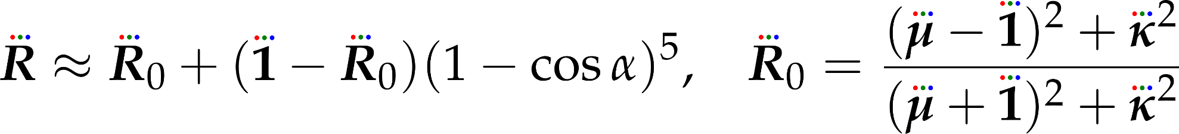

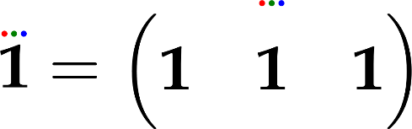
Finding
compute reflectance for every wavelength individually
with all operations on vectors (including squaring) interpreted per-element

Slide 11
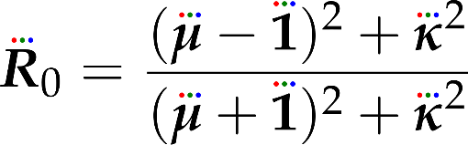
In practice
Gold
Silver
implement recursive ray tracing for
instead of material property R (reflectance) store material property R0 (reflectance at perpendicalar viewing)
you can look up material properties at https://refractiveindex.info, we are interested in wavelengths R=650nm, G=532nm, B=473nm
compute R0 with formula
now make the reflectance depend on alpha = dot(-rayDir, normal) at every bounce, use formula

Slide 12
Precedural texturing and Normal mapping

Slide 13
Procedural noise function and its gradient
float noise(vec3 r) {
uvec3 s = uvec3(
0x1D4E1D4E,
0x58F958F9,
0x129F129F);
float f = 0.0;
for(int i=0; i<16; i++) {
vec3 sf =
vec3(s & uvec3(0xFFFF))
/ 65536.0 - vec3(0.5, 0.5, 0.5);
f += sin(dot(sf, r));
s = s >> 1;
}
return f / 32.0 + 0.5;
}
vec3 noiseGrad(vec3 r) {
uvec3 s = uvec3(
0x1D4E1D4E,
0x58F958F9,
0x129F129F);
vec3 f = vec3(0, 0, 0);
for(int i=0; i<16; i++) {
vec3 sf =
vec3(s & uvec3(0xFFFF))
/ 65536.0 - vec3(0.5, 0.5, 0.5);
f += cos(dot(sf, r)) * sf;
s = s >> 1;
}
return f;
}

Slide 14
Pseudo-code for Wood
Wood
class Wood {
Wood() {
scale = 16;
turbulence = 500;
period = 8;
sharpness = 10;
}
float3 getColor( float3 position) {
float w =
position.x * period + // fractional part of this linear term
// would be just stripes
// so perturb it with noise:
pow( noise(position * scale), sharpness)*turbulence;
w -= int(w + 10000.0) – 10000.0; // take fractional part
return // combine
float3(1, 0.3, 0) * w + // light wood
float3(0.35, 0.1, 0.05) * (1-w)); // dark wood
}
};

Slide 15
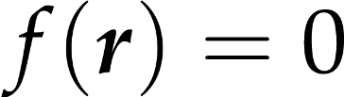
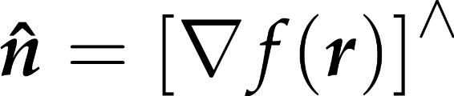
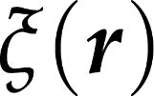
Procedural normal mapping
surface equation
surface normal formula
noise function
perturbed surface equation
thus: just add gradient-of-noise to quadric gradient, then normalize
Oranges

